Slide 1
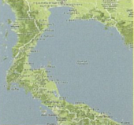
February
EPMI drills and discovers Pilong-1 gas well (29 Mmscf/d) in the Joint Development Area.
April
Petroleum Development Act promulgates in Malaysia vesting exclusive rights to PETRONAS.
January
Thailand announces designation of offshore blocks' boundary for petroleum Exploration and Production (E&P) in Gulf of Thailand.
EPMI later signed preliminary Production Sharing Contract with PETRONAS over its original contract area.
May
Thailand officially proclaims its continental shelf boundary.
1968
1971
1973
1974

Slide 2
February
EPMI drills and discovers Pilong-1 gas well (29 Mmscf/d) in the Joint Development Area.
April
Petroleum Development Act promulgates in Malaysia vesting exclusive rights to PETRONAS.
January
Thailand announces designation of offshore blocks' boundary for petroleum Exploration and Production (E&P) in Gulf of Thailand.
EPMI later signed preliminary Production Sharing Contract with PETRONAS over its original contract area.
May
Thailand officially proclaims its continental shelf boundary.
1968
1971
1973
1974

Slide 3
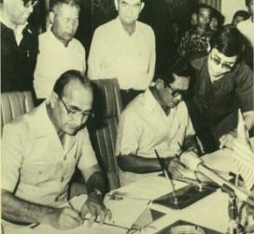
February
Government officials of Malaysia and Thailand meet to discuss problems regarding overlapping offshore area.
Malaysia and Thailand officials meet again; respective boundary claims verified and recognised as difficult to resolve.
October
MOU ratified by both countries in Kuala Lumpur.
February
May
Malaysian and Thai Governments set up Joint MTJA Committee to discuss implementation of MOU; sub-committees also set up: e.g. legal, technical, revenue and tax, customs and excise, organisation, PSC drafting.
Recommendations jointly made to Governments for both sides to suspend any E&P activities in the disputed area until the boundary issue is resolved
21 February
Memorandum of Understanding signed in Chiangmai between the Prime Minister of Malaysia and the Prime Minister of Thailand on the establishment of MTJA to explore and exploit resources in the Joint Development Area.
1976-77
1978
1979
1980

Slide 4
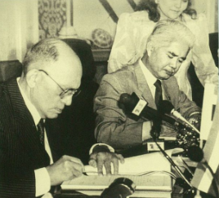
November
Malaysian and Thai Governments endorse MTJA-Comm. Recommendation on the solution and new PSC formula.
July
MTJA Committee meeting in Bangkok recommended four-part solution regarding contractors concessionaries in MTJDA and a new modified PSC formula for Goverments approval.
July
MTJA Act passed in both Parliaments
22 January
May
Simultaneous promulgation of the Malaysia-Thailand Joint Authority Act 1990 (Act 440) in Malaysia and the Thailand-Malaysia Joint Authority Act B.E. 2533 in Thailand.
19 October
Agreement on the Constitution of MTJA signed in Kuala Lumpur between the Foriegn Minister of Malaysia and Foreign Minister of Thailand providing detailed implementation framework for the MTJA
Adoption of Joint Authority Constitution
1981
1989
1990
1991

Slide 5
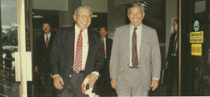
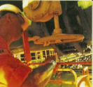
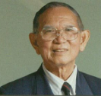
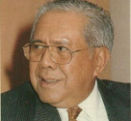
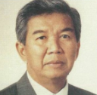
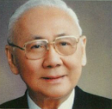
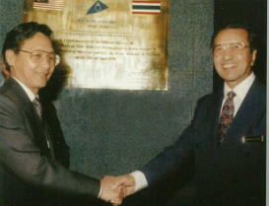
11-12 September
Signing of two Production Sharing Contracts between MTJA and its Contractors of Block A-18 and Blocks B-17 & C-19.
First MTJA meeting held in Bangkok. Head Office location and appointment of CEO decided.
November
Gas discovery confirmed in Block B-17 of the MTJDA after CPOC successfully drilled and completed Muda-1 well.
Appointment of first Chief Executive Officer of the MTJA, Charu-Udom Ruangsuvan from Thailand.
Draft PSC approved for commencement of negotiation with contractors.
August
February
Appointments of first Co-Chairmen and Members of MTJA.
21 April
First Gas Discovery confirmed in Block A-18 of the MTJDA after CTOC successfully drilled and completed well Cakeravwala-1A.
Set-up of MTJA Head Office in Kuala Lumpur
Tengku Tan Sri Dato' Ahmad Rithauddeen bin Tengku Ismail and H.E.M.R. Kasem Samosorn Kasemsri (Co-Chairmen of MTJA)
Appointment of second Thai Co-Chairman of MTJA, H.E. Mr. Bhichai Rattakul.
1992
1994
1995

Slide 6
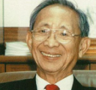
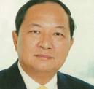
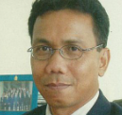
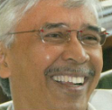
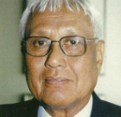
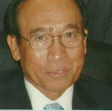
Appointment of third Thai Co-Chairman of MTJA, H.E. Mr. Sivavong Changkasiri.
01 October
Appointment of the third Chief Executive Officer of MTJA, Dr. Kurujit Nakornthap from Thailand.
October
Appointment of the second Chief Executive Officer of MTJA, Ismail Sulaiman from Malaysia.
01 October
Appointment of the fourth Chief Executive Officer of MTJA, Zarei Mohamed from Malaysia.
Appointment of third Malaysian Co-Chairman of MTJA, Tan Sri Abu Talib Othman.
Cakerawala Processing Platform (CPP) produced its 1st gas production at Block A-18
Appointment of second Malaysian Co-Chairman of MTJA, Tan Sri Datuk Ahmad Kamil.
30 September
Signing of Production Sharing Contract between MTJA and Contractors for the right to explore and exploit petroleum in Block B-17-010f MTJDA.
1996
2000
2004
2005

Slide 7
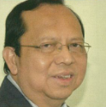
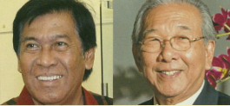
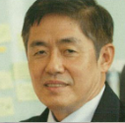
15 January
Muda Processing Platform (MDPP) produced its 1st gas production at Block B-17
Appointment of the fifth Chief Executive Officer of MTJA, Abd Halim Che Abas from Malaysia.
February
01 October
Commenced Phase 2 Development
Appoinment of the fourth Malaysian and Thailand Co-Chairmen of the MTJA, Tan Sri Khalid Ramli and H.E. Napadon Mantajit.
01 October
Appointment of the sixth Chief Executive Officer of MTJA, Suriyan Aphiraksatyakul from Thailand.
2006
2007
2008
2009

Slide 8
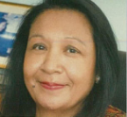
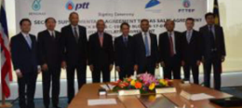
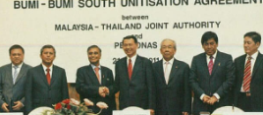
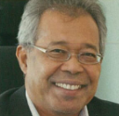
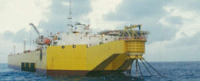
21 August
Signing of the 2nd Agreement to Gas Sales Agreement (SAGSA) for Block B-17 & C-19 and Block B-17-01 and other related agreement.
October
Appointment of the fifth Malaysian Co-Chairperson, Datuk Noriyah Binti Ahmad
12 July
May
Signing of Data Exchange and Confidentiality Agreement (DECA) for Bulan South (Block A-18) and Bunga Bakawali Fields
In May, Cakerawala condensate sales reach cumulatively 10 million barrels in Block A-18
23 March
Signing of Suriya (Block A-18) and Suriya Selatan (Block PM2) Unitisation Agreement.
Later that year, Cakerawala cumulatively 1 triliion standard cubic feet (Tcf)gas sales production in Block A-18
April
Signing ceremony of the Bumi-Bumi South Unitization Agreement
January
October
Launching of MTJA Book
Appointment of the seventh CEO, Datuk Rosli Boni from Malaysia
2010
2011
2012
2013

Slide 9
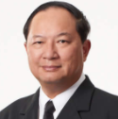
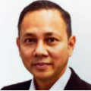
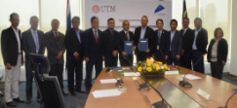
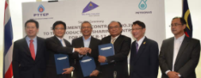
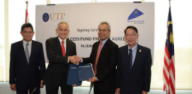
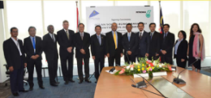
01 October
Appointment of the eighth CEO, Dr. Witsarut Thungsuntonkhun from Thailand and DCEO, Mr. Abdul Muluk bin Abd. Wahab from Malaysia
October
Appointment of the fifth Thai Co-Chairman of the MTJA, Dr. Kurujit Nakornthap.
24 August
23 August
Reasearch Cess (Signing at MTJA Office) MTJA & Universiti Teknologi Malaysia (UTM)
Supplementary Contract (No.2) to the Production Sharing Contract for Block B-17-01- 23Aug 2016 (signing at MTJA Office)
16 June
Reasearch Cess (Signing at MTIA Office) MTJA & Universiti Teknologi PETRONAS (UTP).
The Bulan South-Bunga Bakawali Unitisation Agreement was signed by MJA and PETRONAS at MTJA Office
Unitisation Agreement Signing (Bulan South­ Bunga Bakawali).
23 February
2015
2016

Slide 10
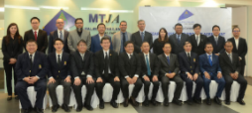
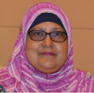
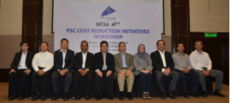
12 September
Research Cess (Signing at MTJA Office) MTJA, UTM and CHULALONGKORN
29 June
Appointment of the sixth Malaysian Co-Chairperson,
YBHG. Tan Sri Dr. Rahamat Bivi Binti Yusoff
01 October
Appointment of the nineth CEO, Mr. Emi Suhardi Mohd. Fadzil from Malaysia and DCEO, Mr. Supat Napanoparatkaew from Thailand.
22 February
MTA 4th PSC Cost Reduction Initiatives Workshop
2017
2020

Slide 11
01 January
Appointment of the tenth CEO, Datuk Joseph Podtung from Malaysia
2022

Slide 12
2021

