Slide 1
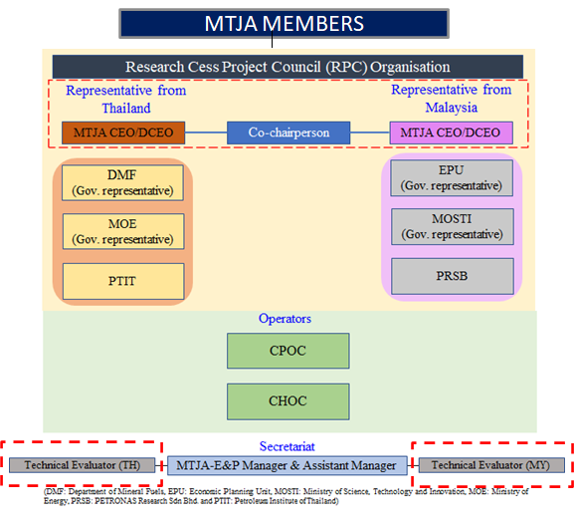
RESEARCH CESS PROJECT COUNCIL ORGANIZATION (RPC)
MTJA Research Cess Project Council (RPC) was formalized on 20th February 2013 which consist of 10 members. RPC was reorganized and approved at 133rd Board Meeting on 20th March 2021. The revised RPC members as below:

Slide 2
RPC MEMBERS
Representative from Thailand
Representative from Malaysia
Mr. Supat Napanoparatkaew
Deputy Chief Executive Officer
MTJA
Co-Chairperson
Mr. Emi Suhardi Mohd Fadzil
Chief Executive Officer
MTJA
Alternate representative
Dr Chanida Kaewkor
Geologist, Senior Professional Level (Leader of MTJDA Group), DMF
Mr. Moktar Idham Musa
Deputy Director II,
Energy Division
Economic Planning Unit
Mdm. Zaeidah Mohamed Esa
Director,
Energy Division,
Economic Planning Unit
Ms. Jomkwan Polak
Plan and Policy Analyst, (Professional Level), Ministry of Energy
Ms Natthawee Ruksakwaew
Plan and Policy Analyst, (Professional Level), Ministry of Energy
Mdm. Fairul Azida binti Shaharudin
Senior Under Secretary
Transfer of Technology and R&D Commercialization, MOSTI
Dr. Nor Azlina binti Ariffin
Secretary,
Transfer of Technology and R&D Commercialization, MOSTI
Ms Dusadee Chareonchitswad
Deputy Executive Director of Petroleum Institution of Thailand (PTIT)
Mrs Prapai Numthavaj
Senior Advisor Petroleum Institution of Thailand (PTIT)
Dr. Nasir bin Darmen
Chief Technology Officer,
Group Research and Technology
PETRONAS Research Sdn. Bhd
Dr. Shahidah binti Mohd Shariff
Chief Executive Officer (CEO) and Head Technology Research
PETRONAS Research Sdn. Bhd
Dr. Terapol Phoonsiri
General Manager
(Carigali PTTEPI)
William Ramsay
General Manager
(Carigali Hess)
Operators
Technical Evaluators
Secretariat
Technical Evaluators
Mr. Tongchai Tonsuwannarat
Advisor of PTIT (PTIT)
Mr. Kavin Punyasmita
CPOC Sub-Surface Planner
(Carigali PTTEPI)
Ms Raja Puteri Norazlina Raja Abdullah
E&P Manager
MTJA
Mr. Wijaiyut Prapawit
E&P Assistant Manager
MTJA
Dr Vichai Maroongroge
Pre-Development Team Lead
(Carigali Hess)
Dr M Faizal B Sedaralit
Chief Scientist in Group Research and Technology (GR&T) (PRSB)
Open

Slide 3
ROLES OF TECHNICAL EVALUATOR
Review each research proposals received by MTJA from Universities focusing on project background, objectives and details (work scope, cost estimate, duration, etc).
Evaluate project viability for implementation that benefit JDA, Malaysia and Thailand.
Recommend and present the suitable projects to Research Cess Project Council (RPC)

Slide 4
PROPOSAL SELECTION & APPROVAL PROCESS
Source: 133rd BP

Slide 5
RESEARCH POTENTIAL AREA / FOCUS TOPIC
No. | Category | Research Area/Topic
1. | Sand Production | Sand production and implication Reduce the sand production Sand control equipment Sand removal
2. | CO2 | Separation of CO2 from Natural Gas New technology of capture or storage Monetize the CO2
3. | Facilities | Pipeline/Platform Integrity Asset Integrity Monitoring system/Pipeline inspection Plant reliability improvement Optimize the facilities performance and minimize operational problem (ex: Acid gas removal, Separator, Mercury Removal Unit, Dehydration, etc) Corrosion/Erosion Study Prolong aging facilities
4. | Power | Alternative/Green Energy for platform Wave energy
5. | Subsurface/RE | Petrophysics for development AI for subsurface prediction Reservoir management Water Production Handling Reservoir modeling Sand prediction Tectonostratigraphy in JDA Paleoenvironment in JDA
Open

Slide 6
RESEARCH POTENTIAL AREA / FOCUS TOPIC
No. | Category | Research Area/Topic
6. | HSE | Environmental impact assessment of the JDA Environmental monitoring Process Safety Management Hazardous Waste Handling
7. | Decommissioning | Decommissioning Decommissioning Cost Estimation Environmental impact of Decommissioning process
8. | Drilling | Drilling innovation Cost saving for drilling activities
Open

